Slide 1

FACIAL EXPRESSION
RECOGNITION
Group 42
Guided By-Dr Anil Kumar

Slide 2
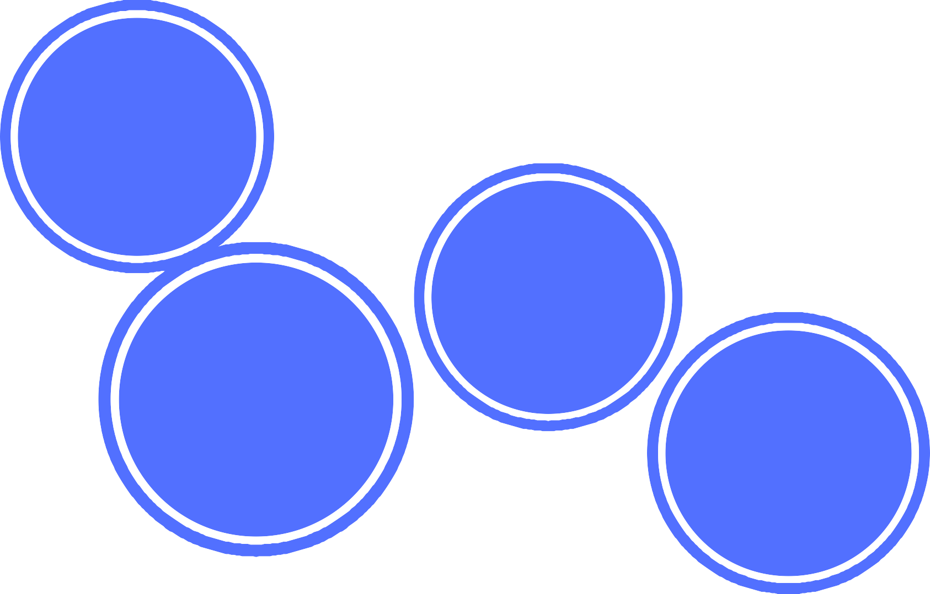
OUR TEAM
Sumaya Prakash Mohapatra 21BAI10256
Purva Samar 21BAI10356
Jigyasa Shukla 21BAI10160
Dibyajyoti Gouda 21BAI10259
Gautam Sidhanth 21BAI10417

Slide 3

Contents
Introduction
Scope of the Project Software Requirements Architectural Diagram
Problem Statement
Implementation
Application

Slide 4
Contribution
Idea Formulation-
Sumaya, Dibyajyoti, Purva
NumPy/ Pandas-
Purva, Jigyasa
Research-
Purva, Jigyasa
Model Building-
Dibyajyoti, Sumaya
Graph Plotting/PPT Completion-
Goutam
Open Cv –
Dibyajyoti, Sumaya

Slide 5
Introduction
The goal of real-time feedback on physiological changes, stress monitoring, and even emotion detection is becoming a technological reality. People in their daily life experience varying emotional states, some of which are negative and which can lead to decreased attention, decreased productivity, and ultimately, reduced quality of life. Therefore, having a solution that continuously monitors the physiological signals of the person and assesses his or her emotional well-being could be a very valuable tool. This paper aims to review existing physiological and emotional monitoring devices, highlight their features and compare their sensing capabilities.
Such technology would be particularly useful for certain populations who experience rapidly changing emotional states such as people with autism spectrum disorder and people with intellectual disabilities. Wearable sensing devices present a potential solution that can support and complement existing behavioral interventions.

Slide 6
Objective
We want to propose software of Emotional detection for a recreational purpose which will detect the expression through camera sensors attached to a recreational device and convert that information to some animated or emoji-type output.
In this study, we developed and validated an algorithm to recognize emotions using multi-channel responses obtained from the device.

Slide 7
Software Requirements
Python
OpenCV/ MATLAB
Convolution Neural Network(CNN) NumPy, Pandas
Tensorflow

Slide 8
Use of all the required softwares

Slide 9
Python We are going to use some libraries like- Matplotlib : This library is responsible for plotting numerical data. And that’s why it is used in data analysis. Used to make pie charts, histogram, graphs etc. Numpy : The name “Numpy” stands for “Numerical Python”. It supports large matrices and multi-dimensional data. Pandas : It is used to provides flexible high-level data structures and a variety of analysis tools Pandas support operations like Sorting, Re-indexing, Iteration, Concatenation, Conversion of data, Visualizations, Aggregations, etc. Seaborn : It is a library in python which provides beautiful default styles and color palettes to make statistical plots more attractive. OS : The OS module in Python provides functions for creating and removing a directory (folder), fetching its contents, changing and identifying the current directory, etc.

Slide 10
Open CV OpenCV (Open Source Computer Vision Library) is an open-source computer vision and machine learning software library. which is built to provide a common infrastructure for machine learning algorithms and computer vision. It has thousands of optimized algorithms which can be used different purposes like detecting and recognizing faces, identifying objects and many more. We need it to take pictures using our webcam and some manipulation needed to be done in the image. CNN The Convolutional Neural Network (CNN or ConvNet) is a subtype of Neural Networks that is mainly used for applications in image and speech recognition. Its built-in convolutional layer reduces the high dimensionality of images without losing its information. That is why CNNs are especially suited for this use case.

Slide 11
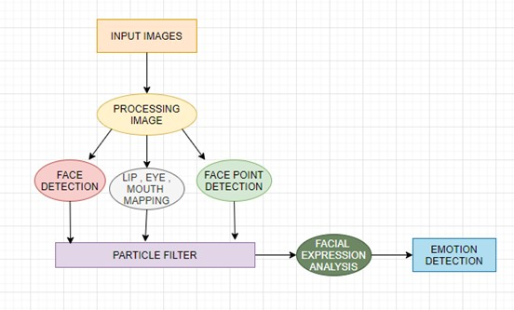
Architectural Diagram

Slide 12
Problem Statement
Automatic face recognition is a particularly complex task that involves the detection and location of faces in a cluttered background, followed by normalization and recognition.
The main problem of face recognition is the large variability of the recorded images due to pose, illumination conditions, facial expressions, use of cosmetics, and different hairstyle presence.
Images of the same individual taken at different times may exhibit more variability due to the aforementioned factors, than images of different individuals due to gender, race, age, and individual variations extra personal variability.
One way to deal with variations is to include them in the training set images. This is a good practice for variations such as facial expressions, use of cosmetics, and the presence of glasses, but it may not be successful in case of illumination or pose variations.

Slide 13
Implementation
The following four steps comprise the facial recognition technology implementation process:
1) Picture Capture
2) Photo Editing
3) Identifying Features Location
4) Developing Templates
5) Template Comparison

Slide 14
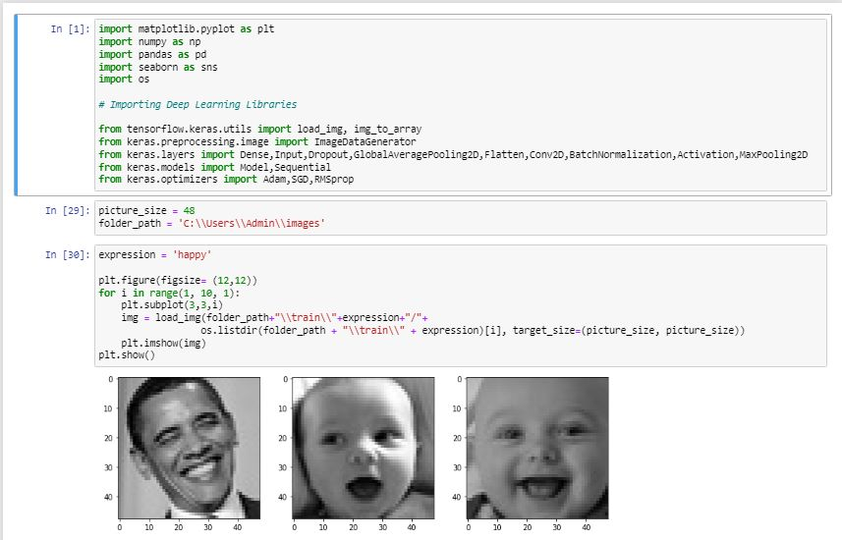
Importing Modules

Slide 15
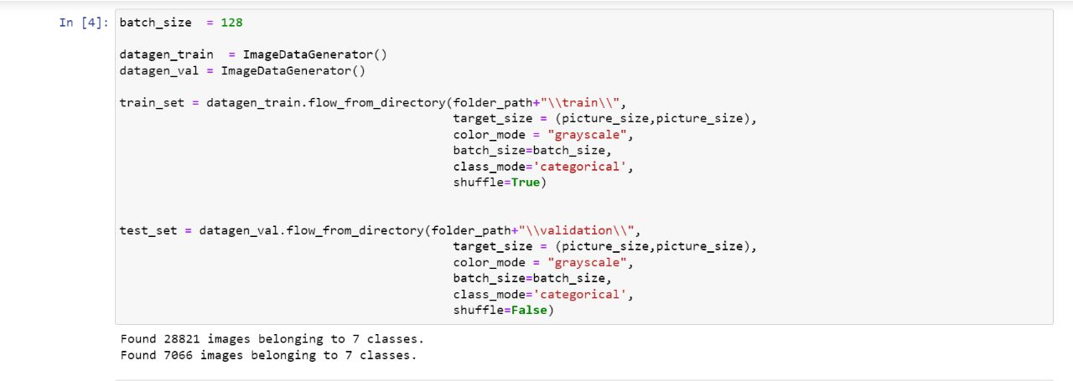
Splitting the Data

Slide 16
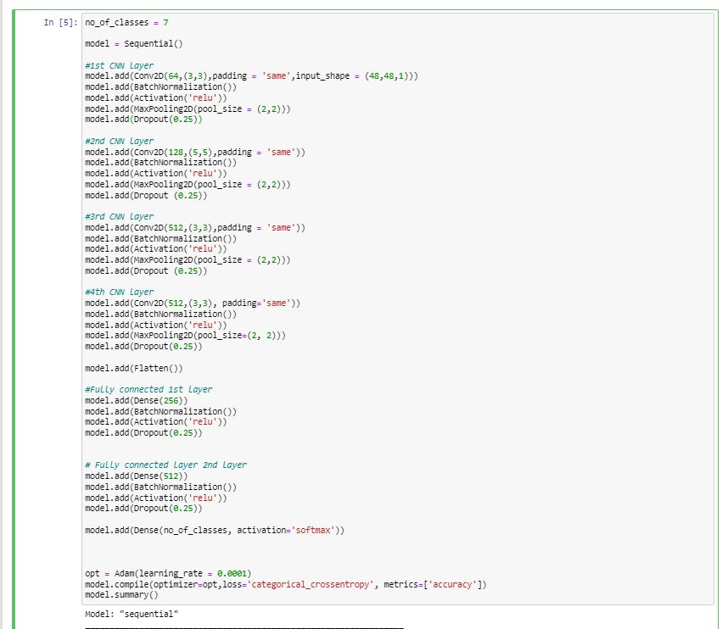
Model Building

Slide 17
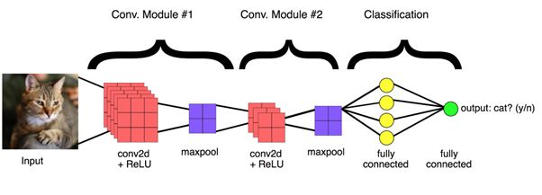
Layers Of CNN

Slide 18
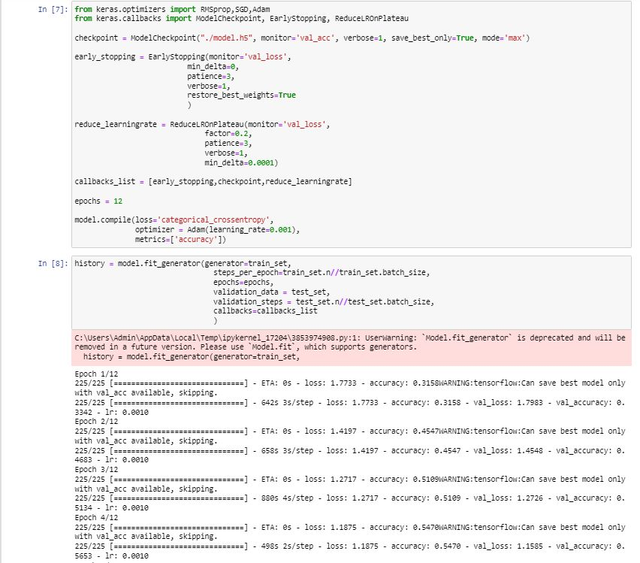
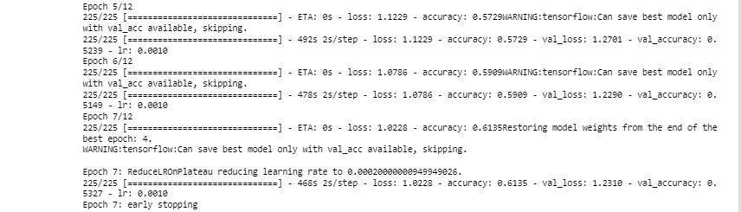
Fitting/Training the Model

Slide 19
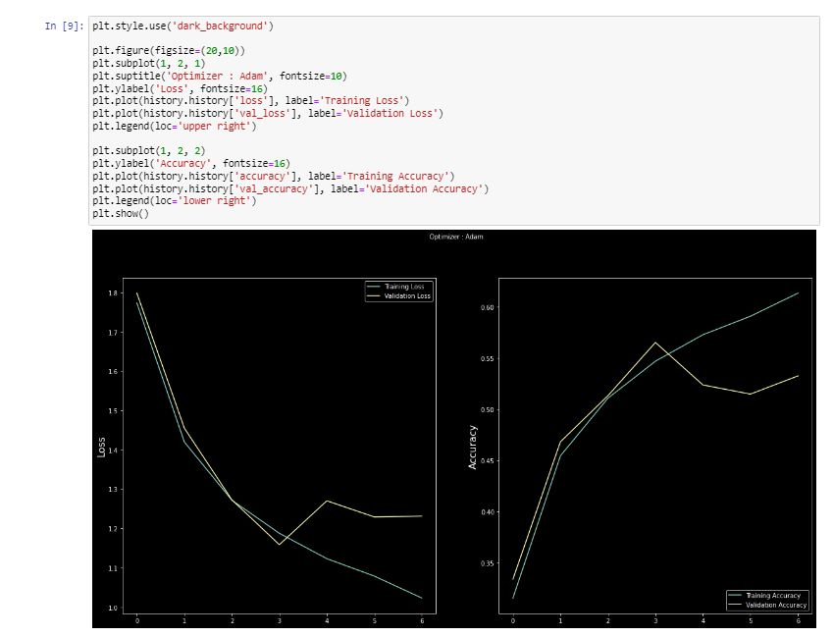
Graph Plotting

Slide 20
Open CV Implementation
The following four steps comprise the implementation process in Open CV:
OpenCV is a video and image processing library and it is used for image and video analysis, like facial detection, license plate reading, photo editing, advanced robotic vision, and many more.
The dlib library contains our implementation of ‘deep metric learning’ which is used to construct our face embeddings used for the actual recognition process.
The face recognition library is super easy to work with and we will be using this in our code. First, remember to install dlib library before you install face recognition.

Slide 21
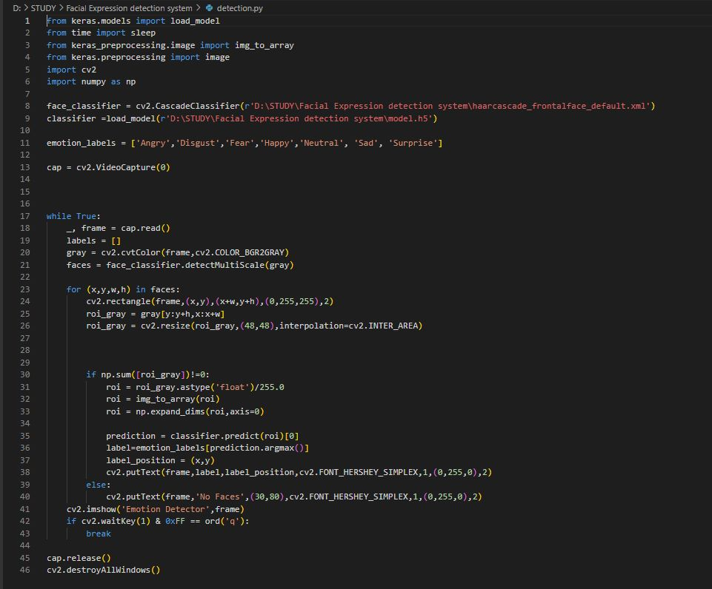
Extracting Features and Recognize Face

Slide 22
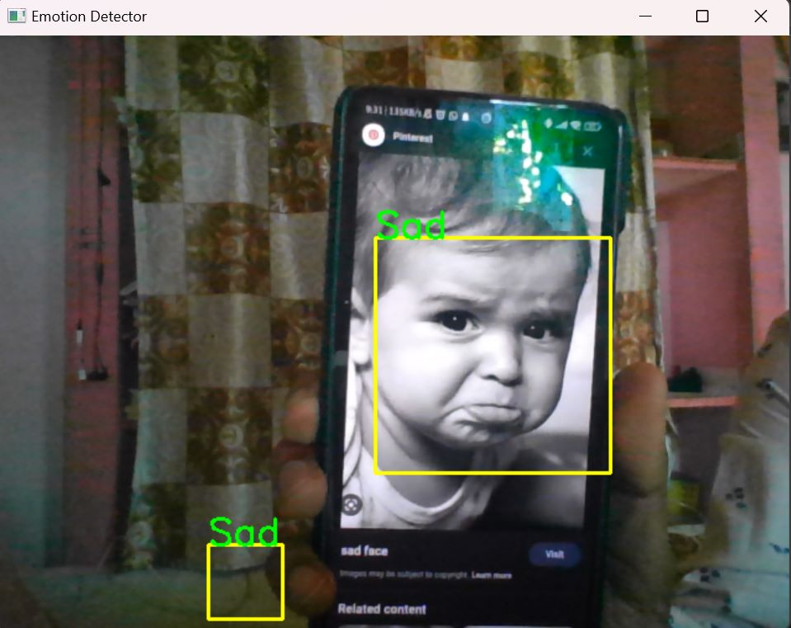
OUTPUT

Slide 23
Application
It is an AI-based technology that helps to identify human faces in images. It uses facial expressions to identify parts of an image or video to determine age, gender and emotions.
This technology can be applied to fields like-
Security
Check-in Checkout Process for patients
Biometrics
Market Research
Video Game Testing
Law Enforcement
Tracking and Surveillance

Slide 24
Thank You

